Slide 1
일반적인 웹 서비스 데이터수집

Slide 2
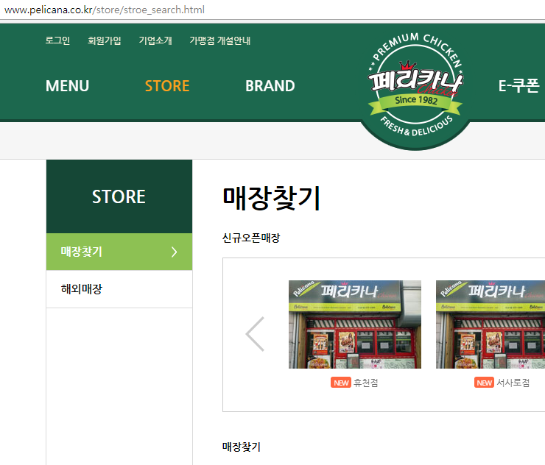
페리카나 매장 찾기

Slide 3
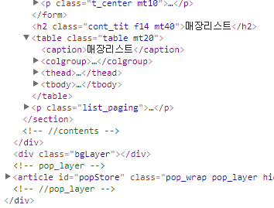
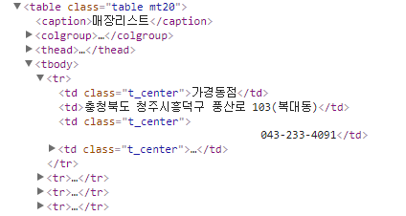
html 소스 확인

Slide 4

url 형식 확인
page=#페이지번호#

Slide 5
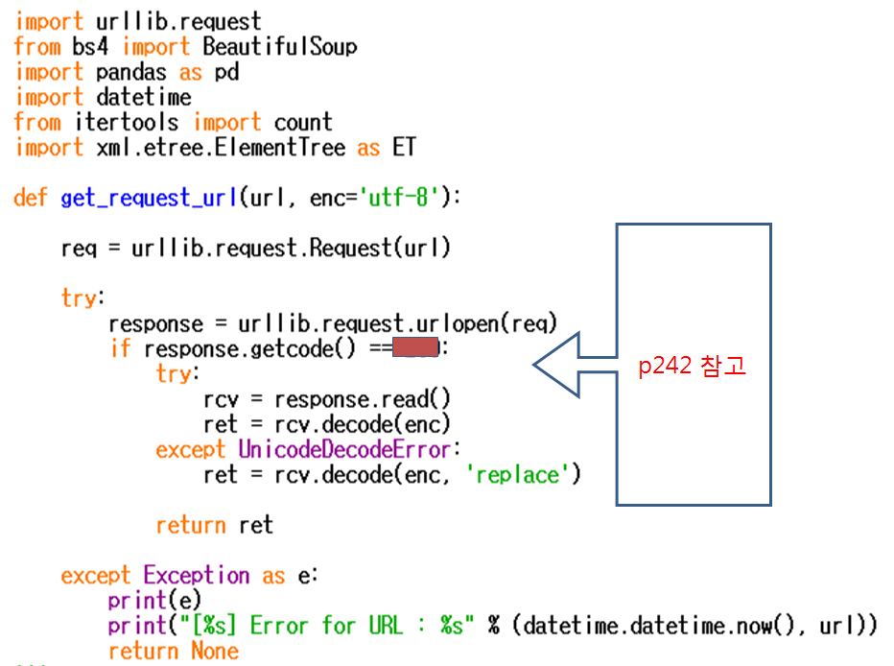
200
Notes:
import urllib.request
from bs4 import BeautifulSoup
import pandas as pd
import datetime
from itertools import count
import xml.etree.ElementTree as ET
def get_request_url(url, enc="utf-8"):
req=urllib.request.Request(url)
try:
response=urllib.request.urlopen(req)
if response.getcode()==200:
try:
rcv=response.read()
ret=rcv.decode(enc)
except UnicodeDecodeError:
ret=rcv.decode(enc,'replace')
return ret
except Exception as e:
print(e)
print("[%s] Error for URL: %s" %(datetime.datetime.now(),url))
def getPelicanaAddress(result):
for page_idx in count():
Pelicana_URL=("http://www.pelicana.co.kr/store/stroe_search.html?page=%s&branch_name=&gu=&si=" %str(page_idx+1))
print("[Pelicana Page]:[%s]" %(str(page_idx+1)))
rcv_data=get_request_url(Pelicana_URL)
soupData=BeautifulSoup(rcv_data,'html.parser')
store_table=soupData.find('table', attrs={'class':'table mt20'})
tbody=store_table.find('tbody')
bEnd=True
for store_tr in tbody.findAll('tr'):
bEnd=False
tr_tag=list(store_tr.strings)
store_name=tr_tag[1]
store_address=tr_tag[3]
store_sido_gu=store_address.split()[:2]
result.append([store_name]+store_sido_gu+[store_address])
if (bEnd==True):
return
def main():
result=[]
print("PELICANA ADDRESS CRAWLING START")
getPelicanaAddress(result)
print(result)
pelicana_table=pd.DataFrame(result, columns=('store','sido','gungu','store_address'))
pelicana_table.to_csv("C:\pelicana.csv", encoding="cp949", mode='w', index=True)
del result[:]
if __name__=="__main__":
main()

Slide 6
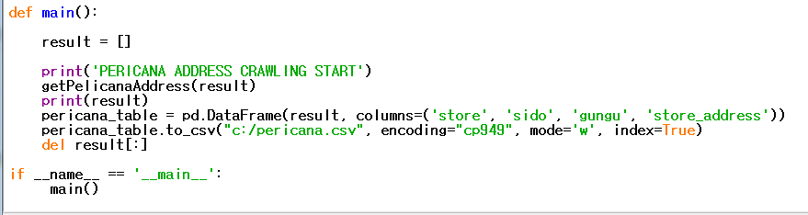
Notes:
import urllib.request
from bs4 import BeautifulSoup
import pandas as pd
import datetime
from itertools import count
import xml.etree.ElementTree as ET
def get_request_url(url, enc="utf-8"):
req=urllib.request.Request(url)
try:
response=urllib.request.urlopen(req)
if response.getcode()==200:
try:
rcv=response.read()
ret=rcv.decode(enc)
except UnicodeDecodeError:
ret=rcv.decode(enc,'replace')
return ret
except Exception as e:
print(e)
print("[%s] Error for URL: %s" %(datetime.datetime.now(),url))
def getPelicanaAddress(result):
for page_idx in count():
Pelicana_URL=("http://www.pelicana.co.kr/store/stroe_search.html?page=%s&branch_name=&gu=&si=" %str(page_idx+1))
print("[Pelicana Page]:[%s]" %(str(page_idx+1)))
rcv_data=get_request_url(Pelicana_URL)
soupData=BeautifulSoup(rcv_data,'html.parser')
store_table=soupData.find('table', attrs={'class':'table mt20'})
tbody=store_table.find('tbody')
bEnd=True
for store_tr in tbody.findAll('tr'):
bEnd=False
tr_tag=list(store_tr.strings)
store_name=tr_tag[1]
store_address=tr_tag[3]
store_sido_gu=store_address.split()[:2]
result.append([store_name]+store_sido_gu+[store_address])
if (bEnd==True):
return
def main():
result=[]
print("PELICANA ADDRESS CRAWLING START")
getPelicanaAddress(result)
print(result)
pelicana_table=pd.DataFrame(result, columns=('store','sido','gungu','store_address'))
pelicana_table.to_csv("C:\pelicana.csv", encoding="cp949", mode='w', index=True)
del result[:]
if __name__=="__main__":
main()

Slide 7
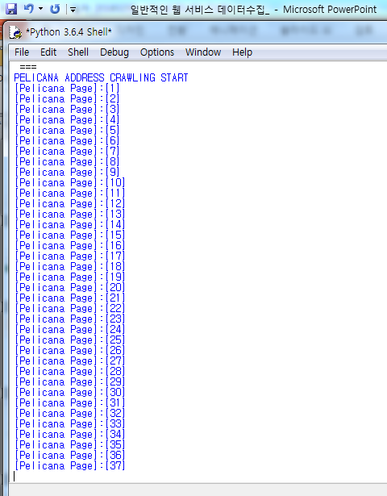
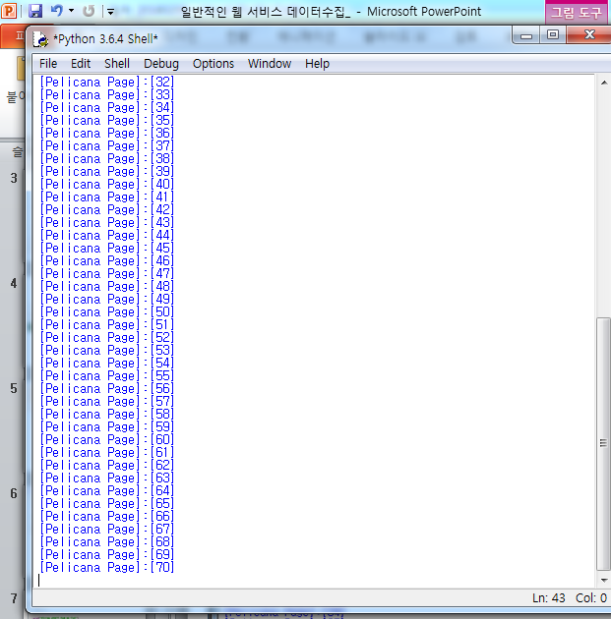
페리카나 매장이 뜸!! 페이지가 다 뜰 때까지 기다린 후 파일이 생성되었는지 확인한다.

Slide 8
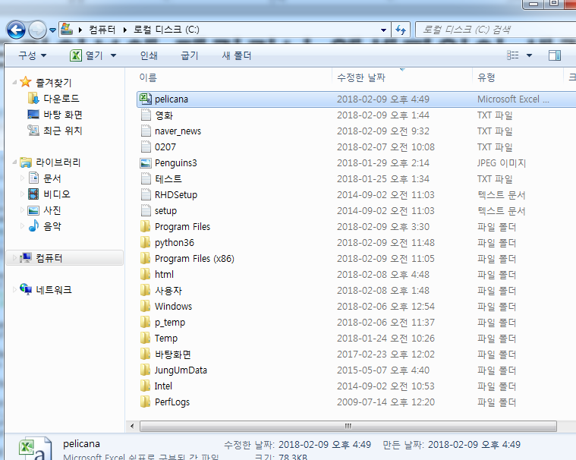
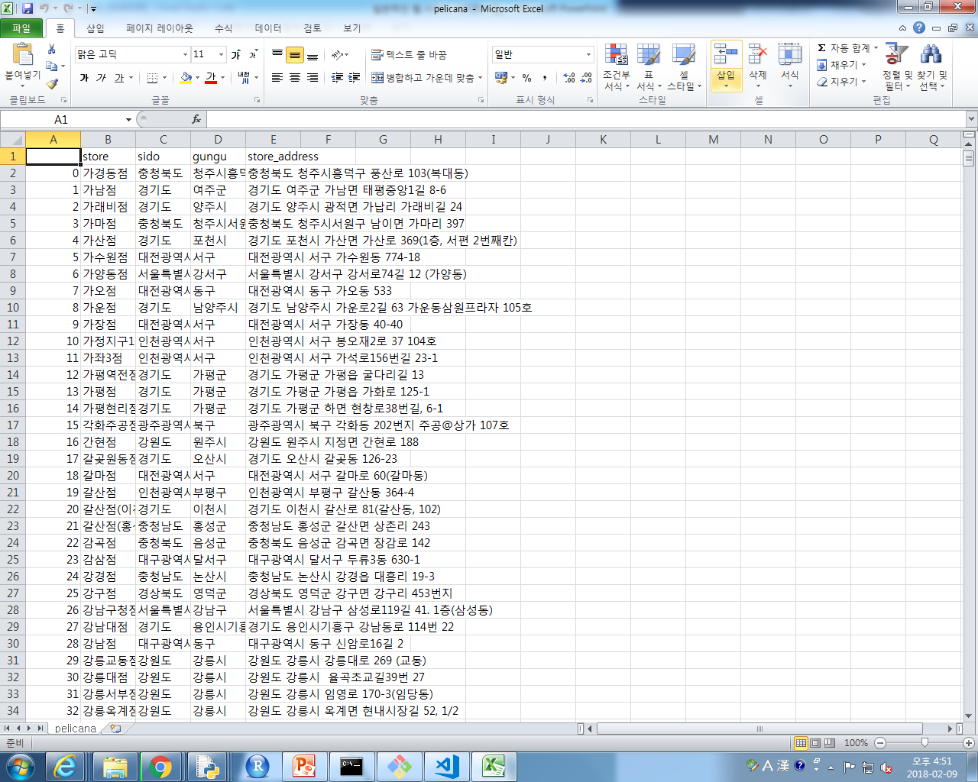
C 드라이브에 페리카나 엑셀파일이 생김
Notes:
import urllib.request
from bs4 import BeautifulSoup
import pandas as pd
import datetime
from itertools import count
import xml.etree.ElementTree as ET
def get_request_url(url, enc="utf-8"):
req=urllib.request.Request(url)
try:
response=urllib.request.urlopen(req)
if response.getcode()==200:
try:
rcv=response.read()
ret=rcv.decode(enc)
except UnicodeDecodeError:
ret=rcv.decode(enc,'replace')
return ret
except Exception as e:
print(e)
print("[%s] Error for URL: %s" %(datetime.datetime.now(),url))
def getPelicanaAddress(result):
for page_idx in count():
Pelicana_URL=("http://www.pelicana.co.kr/store/stroe_search.html?page=%s&branch_name=&gu=&si=" %str(page_idx+1))
print("[Pelicana Page]:[%s]" %(str(page_idx+1)))
rcv_data=get_request_url(Pelicana_URL)
soupData=BeautifulSoup(rcv_data,'html.parser')
store_table=soupData.find('table', attrs={'class':'table mt20'})
tbody=store_table.find('tbody')
bEnd=True
for store_tr in tbody.findAll('tr'):
bEnd=False
tr_tag=list(store_tr.strings)
store_name=tr_tag[1]
store_address=tr_tag[3]
store_sido_gu=store_address.split()[:2]
result.append([store_name]+store_sido_gu+[store_address])
if (bEnd==True):
return
def main():
result=[]
print("PELICANA ADDRESS CRAWLING START")
getPelicanaAddress(result)
print(result)
pelicana_table=pd.DataFrame(result, columns=('store','sido','gungu','store_address'))
pelicana_table.to_csv("C:\pelicana.csv", encoding="cp949", mode='w', index=True)
del result[:]
if __name__=="__main__":
main()

Slide 9
Cmd에서 pip install pandas를 깐다

